Slide 1
Week 13_Lec1
ARP and VLANs

Slide 2

ARP: address resolution protocol
Question: how to determine interface’s MAC address, knowing its IP address?
ARP table: each IP node (host, router) on LAN has table
ARP
137.196.7.78
IP/MAC address mappings for some LAN nodes:
< IP address; MAC address; TTL>
TTL (Time To Live): time after which address mapping will be forgotten (typically 20 min)
1A-2F-BB-76-09-AD
ARP
ARP
LAN
71-65-F7-2B-08-53
58-23-D7-FA-20-B0
137.196.7.23
137.196.7.14
ARP
0C-C4-11-6F-E3-98
137.196.7.88

Slide 3
Send broadcast request
receive unicast response

Slide 7
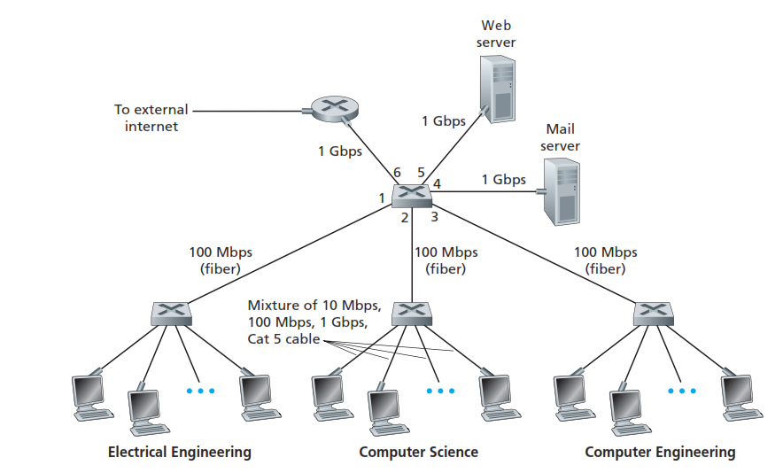
Institutional network

Slide 8


Switches vs. routers
application
transport
network
link
physical
both are store-and-forward:
routers: network-layer devices (examine network-layer headers)
switches: link-layer devices (examine link-layer headers)
both have forwarding tables:
routers: compute tables using routing algorithms, IP addresses
switches: learn forwarding table using flooding, learning, MAC addresses
datagram
frame
link
physical
frame
switch
network
link
physical
datagram
frame
application
transport
network
link
physical

Slide 9
VLANs: motivation
No traffic isolation
all layer-2 broadcast traffic (ARP, DHCP, unknown location of destination MAC address) must cross entire LAN
Inefficient use of switches
Multiple departments with less users
each one switch (96 port )
Wastage of resources
Managing users
CS user moves office to EE, but wants connect to CS switch?

Slide 10
Virtual Local Area Network
A switch that allows multiple Local area networks to be defined over a single physical local area network infrastructure giving an appearance of multiple VLANS on single switch

Slide 11

Port-based VLAN
router
traffic isolation: frames to/from ports 1-8 can only reach ports 1-8
can also define VLAN based on MAC addresses of endpoints, rather than switch port
1
7
9
15
2
8
10
16
dynamic membership: ports can be dynamically assigned among VLANs
…
…
Electrical Engineering
(VLAN ports 1-8)
Computer Science
(VLAN ports 9-15)
forwarding between VLANS: done via routing (just as with separate switches)
in practice vendors sell combined switches plus routers

Slide 12
VLANS spanning multiple switches
1
7
9
15
1
3
5
7
2
8
10
16
2
4
6
8
…
…
Electrical Engineering
(VLAN ports 1-8)
Computer Science
(VLAN ports 9-15)
Ports 2,3,5 belong to EE VLAN
Ports 4,6,7,8 belong to CS VLAN
trunk port: carries frames between VLANS defined over multiple physical switches
frames forwarded within VLAN between switches can’t be vanilla 802.1 frames (must carry VLAN ID info)
802.1q protocol adds/removed additional header fields for frames forwarded between trunk ports

Slide 13
VLANS spanning multiple switches
1
7
9
15
1
3
5
7
2
8
10
16
16
2
4
6
8
…
…
…
EE (VLAN ports 1-8)
CS (VLAN ports 9-15)
Ports 2,3,5 belong to EE VLAN
Ports 4,6,7,8 belong to CS VLAN
trunk port: carries frames between VLANS defined over multiple physical switches
frames forwarded within VLAN between switches can’t be vanilla 802.1 frames (must carry VLAN ID info)
802.1q protocol adds/removed additional header fields for frames forwarded between trunk ports

Slide 14
802.1Q VLAN frame format
type
preamble
dest.
address
source
address
data (payload)
CRC
802.1 Ethernet frame
type
preamble
dest.
address
source
address
data (payload)
CRC
802.1Q frame
2-byte Tag Protocol Identifier
(value: 81-00)
Recomputed
CRC
Tag Control Information
(12 bit VLAN ID field, 3 bit priority field like IP TOS)

Slide 15
Chapter 6: Summary
principles behind data link layer services:
error detection, correction
sharing a broadcast channel: multiple access
link layer addressing
instantiation, implementation of various link layer technologies
Ethernet
switched LANS, VLANs
synthesis: a day in the life of a web request

